Slide 1
Traffic Sign Recognition
Rajanandhini H - 18C075 , Samiksha S - 18C087,Varsha Nair H -18C121

Slide 2
PROBLEM STATEMENT
There are different types of traffic signs such as no entry,speed limits,turn left or right,children crossing, no passing of heavy vehicles etc.
To build a deep neural network model that can classify traffic signs present in the image into different categories.

Slide 3
METHODOLOGIES
In this proposed methodology, the model makes use of an Keras, a neural network library that can run on TensorFlow.
Apart from this, we import various libraries like Conv2D, MaxPool2D, Dense, Flatten, Dropout for building the model and finally compiling the model.In order to prevent over-fitting, Dropout layer is added to the CNN to suppress over-fitting.
The test result of the trained CNN shows that the accuracy of the model in detecting and recognizing traffic signs is 99.7% as training and 97.8 as testing accuracy.

Slide 4
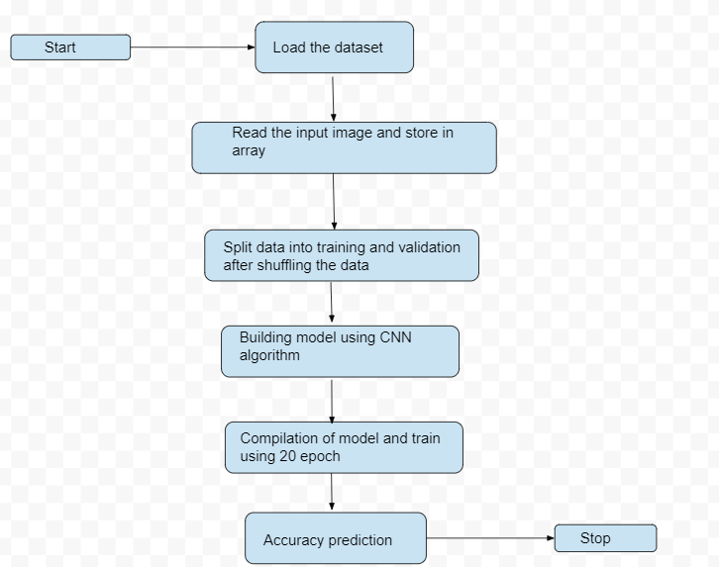
ARCHITECTURE DIAGRAM

Slide 5
Application of Engineering Knowledge
Convolutional Neural Networks
Open CV
Deep Learning
Computer Vision

Slide 6
Convolutional Neural Networks
Convolution neural networks(CNN) can take images as their input.
It is a deep learning algorithm.
It is capable of taking image input and assigning importance to various aspects or objects thus enabling it to differentiate from one image to another.

Slide 7
Open CV
OpenCV -Open Source Computer Vision Library is a platform through which we can develop real time computer vision applications.
It mainly looks into image processing,analysing the features like face detection and object detection.
The library has more than 2500 optimized algorithms.
These algorithms can be used to detect and recognize faces, identify objects, track camera movements etc.

Slide 8
Deep Learning
The deep-learning based detection uses an ensemble of feature extraction network models.
Here, network models can perform localization and classification.
Deep learning is a key technology behind driverless cars, which allows them to recognize a stop sign.

Slide 9
Computer Vision
Computer vision is the field of computer science that focuses on replicating parts of the complexity of the human vision system and enabling computers to identify and process objects in images and videos in the same way that humans do.
Cameras capture video from different angles around the car and feed it to computer vision software, which then processes the images in real-time.

Slide 10
MATHEMATICAL MODELING AND ANALYSIS BEHIND THE PROBLEM
The dataset sorted on the basis of number of images in each class.After sorting it is plotted as a graph.
Correlation heat map is used to compare the measurement of each pair of dimensions. The figure represents the heat map of the dataset.
Mean
Standard Deviation
Covariance
Precision-Recall

Slide 11
RESULT ANALYSIS
Traffic Sign Recognition has been addressed by many techniques.
The most broadly used approach is CNN in traffic sign recognition.
The existing solution has an accuracy of 94% - 95% .
In the proposed methodology the test result of the trained CNN shows that the accuracy of the model in detecting and recognizing traffic signs is 99.7% as training and 97.8 as testing accuracy..

Slide 12
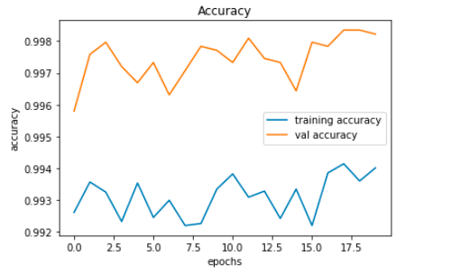
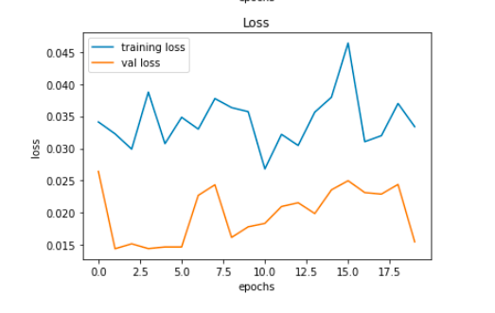


Slide 13
OUTCOME
Failing to notice these traffic signs may directly or indirectly lead to accidents.
Traffic sign recognition (TSR) is an important application in advanced driver assistance systems (ADAS), which helps drivers with vital information.
The major reason for selecting CNN(Convolutional Neural Networks)algorithm is that CNNs have achieved phenomenal accuracy and efﬁciency in image-classiﬁcation.
Compared to many other models the model proposed in this paper shows a much higher accuracy of 99.7% as training and 97.8 as testing accuracy.

Slide 14
CONTRIBUTION OF EACH OF THE TEAM MEMBERS
S.NO | Team Member | Contribution
1. | Rajanandhini H | Dataset Collection
2. | Samiksha S | Model Building
3. | Varsha Nair H | Training and Testing

Slide 15

PROFESSIONAL ETHICS FOLLOWED
Responsibility in handling the data
Maintain the quality of data

Slide 16
REFERENCES
i. Alturki, A.S. Traffic Sign Detection and Recognition Using Adaptive Threshold Segmentation with Fuzzy Neural Network Classification. In Proceedings of the 2018 International Symposium on Networks, Computers and Communications (ISNCC), Rome, Italy, 19–21 June 2018; pp. 1–7.
ii. C.C. Chang et al. A fast VQ codebook search with initialization and search order Inf. Sci.(2012)
iii. De la Escalera, A.; Armingol, J.M.; Mata, M. Traffic sign recognition and analysis for intelligent vehicles. Image Vis. Comput. 2003, 21, 247–258

Slide 17
iv. Loy, G.; Barnes, N. Fast shape-based road sign detection for a driver assistance system. In Proceedings of the 2004 IEEE/RSJ International Conference on Intelligent Robots and Systems, (IROS 2004), Sendai, Japan, 28 September–2 October 2004; pp. 70–75.
v. Pettersson, N.; Petersson, L.; Andersson, L. The histogram feature-a resource-efficient weak classifier. In Proceedings of the 2008 IEEE Intelligent Vehicles Symposium, Eindhoven, The Netherlands, 4–6 June 2008; pp. 678–683.

Slide 18
THANK YOU!

